Slide 1

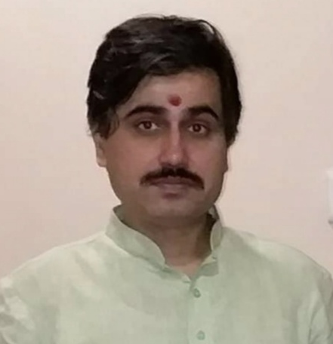
Analog Electronic Circuits (UEC301)
By
Dr.Mayank Kumar Rai
Associate Professor,
ECED,TIET,Patiala

Slide 2

Subject: Analog Electronic Circuits (UEC301)
Faculty names: (1) Dr. Mayank Kumar Rai ( Associate Professor & Course Coordinator)
(2) Dr. Arun Chatterjee (Assistant Professor) and
(3) Dr. Subiman Chatterjee (Assistant Professor)
Topic of today’s Lecture : BJT Biasing-I
Key points
Contents of this lecture are based on the following books:
Purpose of Transistor Biasing
DC operating Points(i/p and o/p)
Effects of Bias point location on Allowable Signal Swing
Stabilization against Variations in I_{CO} and β
Jacob Milman & and C.C.Halkias, “Integrated Electronics Analog and Digital Circuit and Systems”Second Edition.
Adel S. Sedra & K. C. Smith, “MicroElectronic Circuits Theory and Application” Fifth Edition.
Robert L. Boylestad & L. Nashelsky, “Electronic Devices and Circuit Theory” Eleventh Edition.

Slide 3
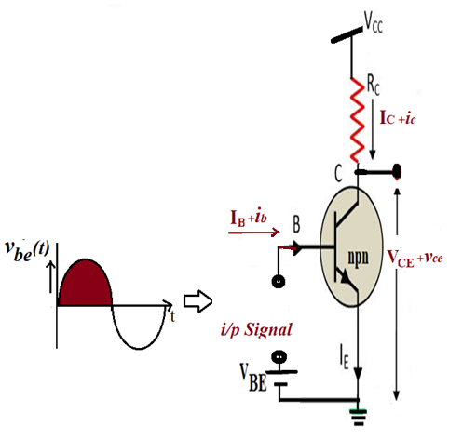
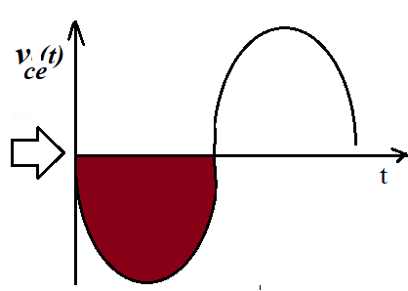
Purpose of Transistor Biasing

Slide 4
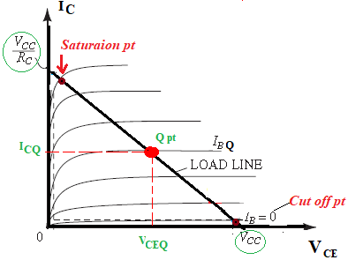
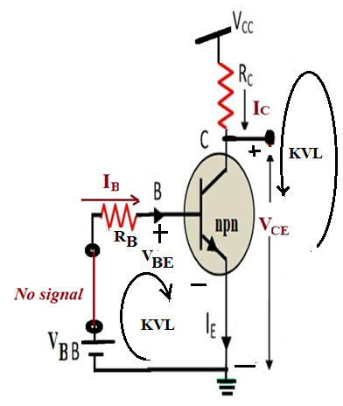
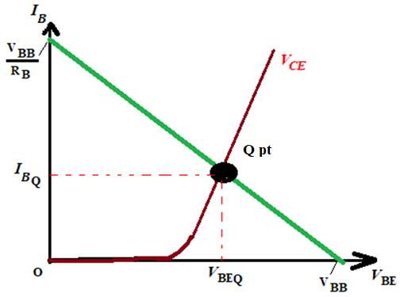
DC operating Points(i/p and o/p)
Output Char.
V_{CE} = V_{CC} – I_{C}R_{C} ... (2)
V_{CE} = V_{CC} when (I_{C}=0)
I_{C} = V_{CC}/R_{C} when (V_{CE} =0)
Input char.
V_{BB} = V_{BE} + I_{B}R_{B} ... (1)
V_{BE} = V_{BB} when (I_{B}=0)
I_{B} = V_{BB}/R_{B} when (V_{BE} =0)

Slide 5
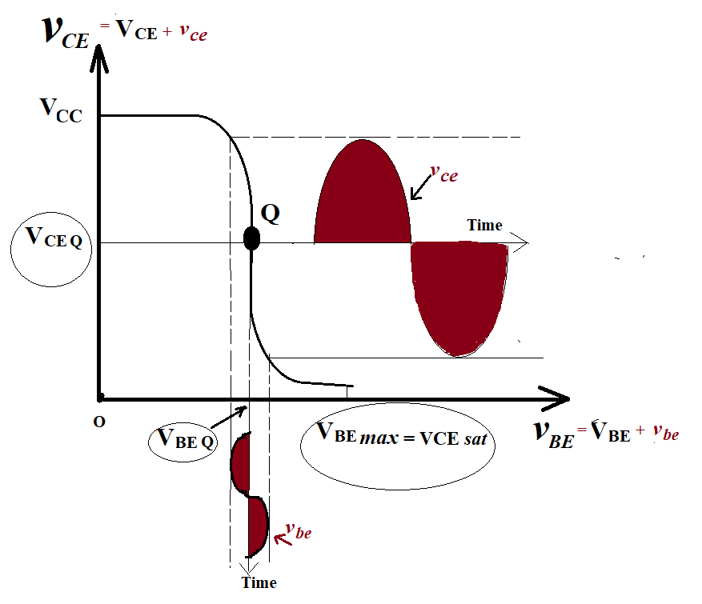



Transfer characteristic of the CEC based CKT, biased at Q point

Slide 6
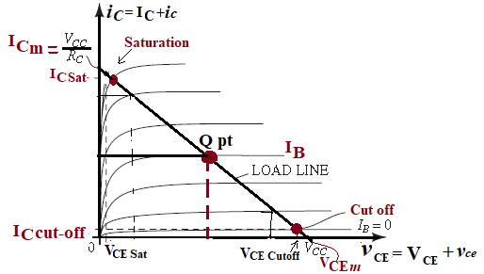
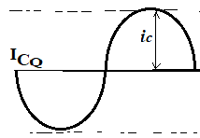
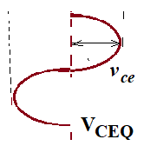
Output characteristic of the CEC based CKT, biased at Q point

Slide 7
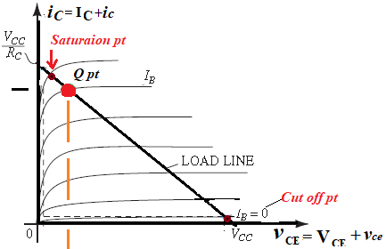
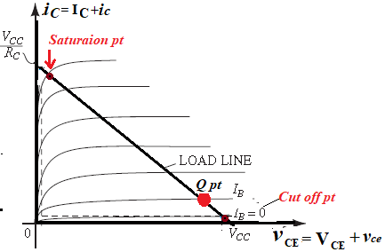
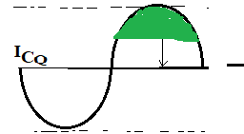
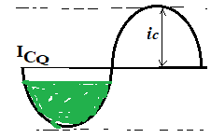
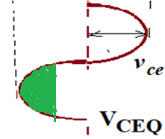
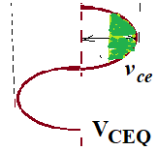
Effects of Bias point location on Allowable Signal Swing

Slide 8
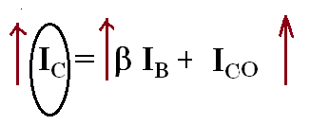

Stabilisation of Q pt. The collector current in transistor changes rapidly when: The temperature changes, I_{C} = β I_{B} + I_{CO} ....(i) β & I_{CO} = function of temperature
Stabilization against Variations in I_{CO} and β
Stability Factor (S) = dI_{C}/dI_{CO}
Thermal Runway

Slide 9
Thank You

